Slide 1

Text Classification - Sentiment Analysis ------------------------------------------------------ Submitted by: Avantika Mishra Deekshya Dash Sanjog Samuel Samantaray

Slide 2

About Sentiment Analysis
India needs a boost to its economy that can also simultaneously transform local businesses. In order to support Indian brands, 'Vocal for Local' campaign was started in India. Emphasizing on a self-reliant, or ‘aatmanirbhar’, India, the Indian government has asked that products not just be made in India, but also for the promotion of local brands, manufacturing, and supply chain.
Data analysis on millions of reviews through Amazon is a crucial factor for the company. These reviews generates a lot of data -- data that can be analyzed and used for advertising, business decisions, understanding of customers' needs and wishes on the products (and platforms), guiding marketing initiatives, implementation of innovative additional services and much more.
This dataset comprises of 2500+ reviews of about 100+ Indian Products pertaining to categories like hair and skin care products, clothes, electronic gadgets, etc from Amazon.

Slide 3

Problem Statement
Many companies fail to perceive the customer’s sentiments from their reviews which leads to an adverse effect on the company sales. The aim is to analyze the sentiments from the reviews and draw significant conclusions to understand what customers need.
The problem in sentiment analysis is classifying the polarity of a given text at the document, sentence, or feature/aspect level: whether the expressed opinion in a document, a sentence or an entity feature/aspect is positive, negative, or neutral.

Slide 4

Objective
This project will perform sentiment analysis, also called opinion mining or emotion AI, and will systematically identify, extract, quantify, and study affective states and subjective information using natural language processing and text analysis.
It aims to provide a working model with a reliable accuracy so that the companies can use it to find out the underlying sentiment of their target audience.

Slide 5
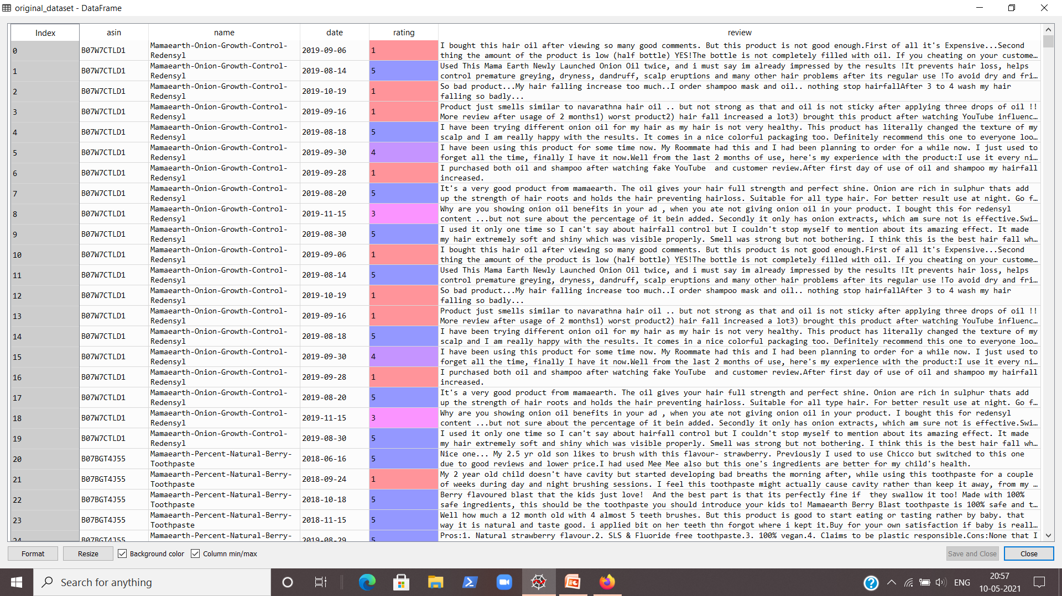
The Original Dataset
Table 1 – The original dataset

Slide 6
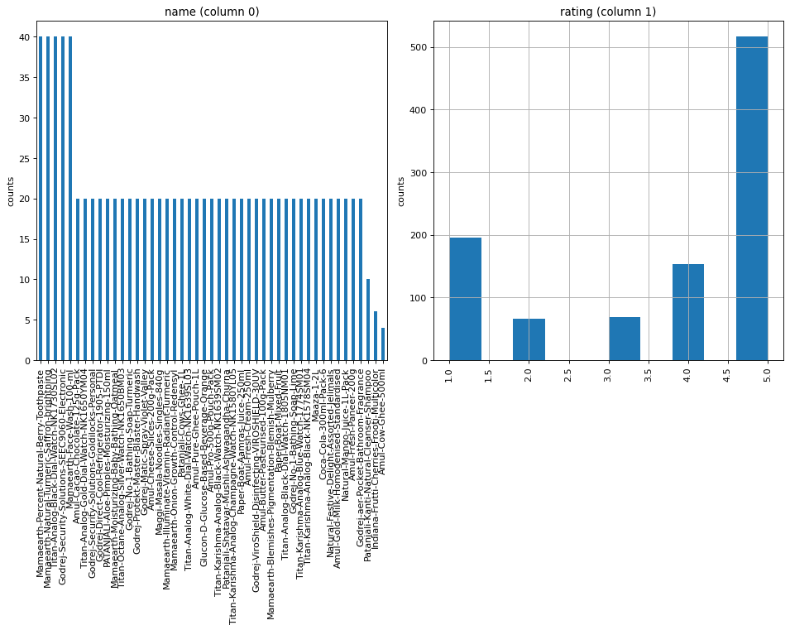
Graph of product i. Name ii. Rating
Fig. 1 – Product name frequency
Fig. 2 – Product rating bar graph

Slide 7
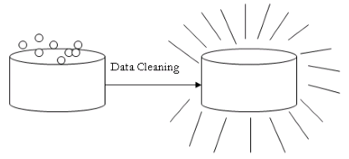
Methodology
Data cleaning and pre-processing
Dropped the rows with null columns.
Removed characters and punctuations except for alphabets and numbers.
Segregated brand name and product name from the name column.
Removed stop-words
Divided text into tokens
Performed sentiment analysis to identify positive, negative and neutral reviews on the basis of sentiment scores.

Slide 8
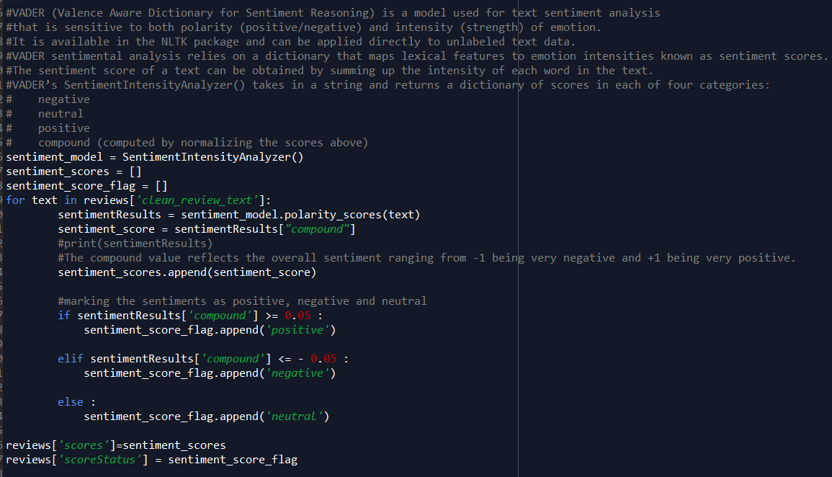
Performed
Sentiment
Analysis
Fig. 3 – Code for sentiment analysis

Slide 9
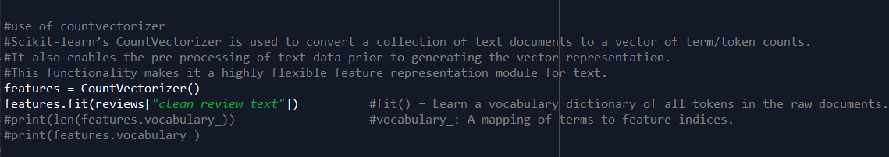
Methodology (continued..)
Converted the text to a vector of token counts using CountVectorizer().
Split the original data-frame into two separate data-frames containing positive and negative reviews.
Assigned binary values to the positive, negative and neutral reviews.
Fig. 4 – Code for CountVectoriser()

Slide 10
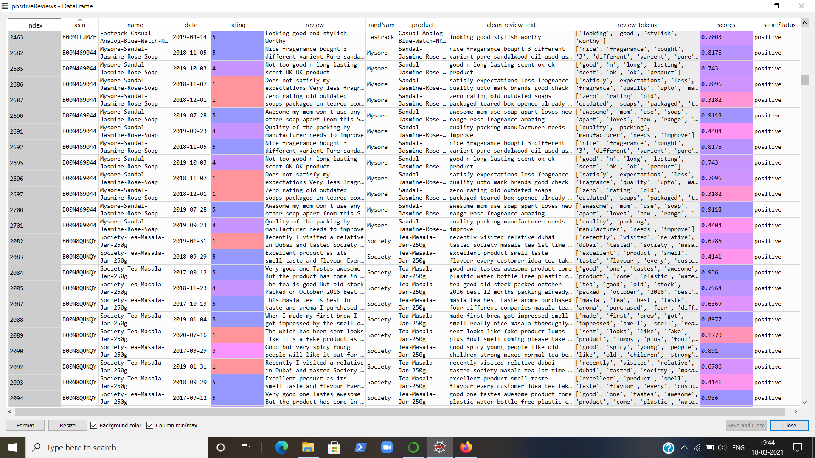
Positive Reviews
Table 2 – Positive Reviews Data-frame

Slide 11
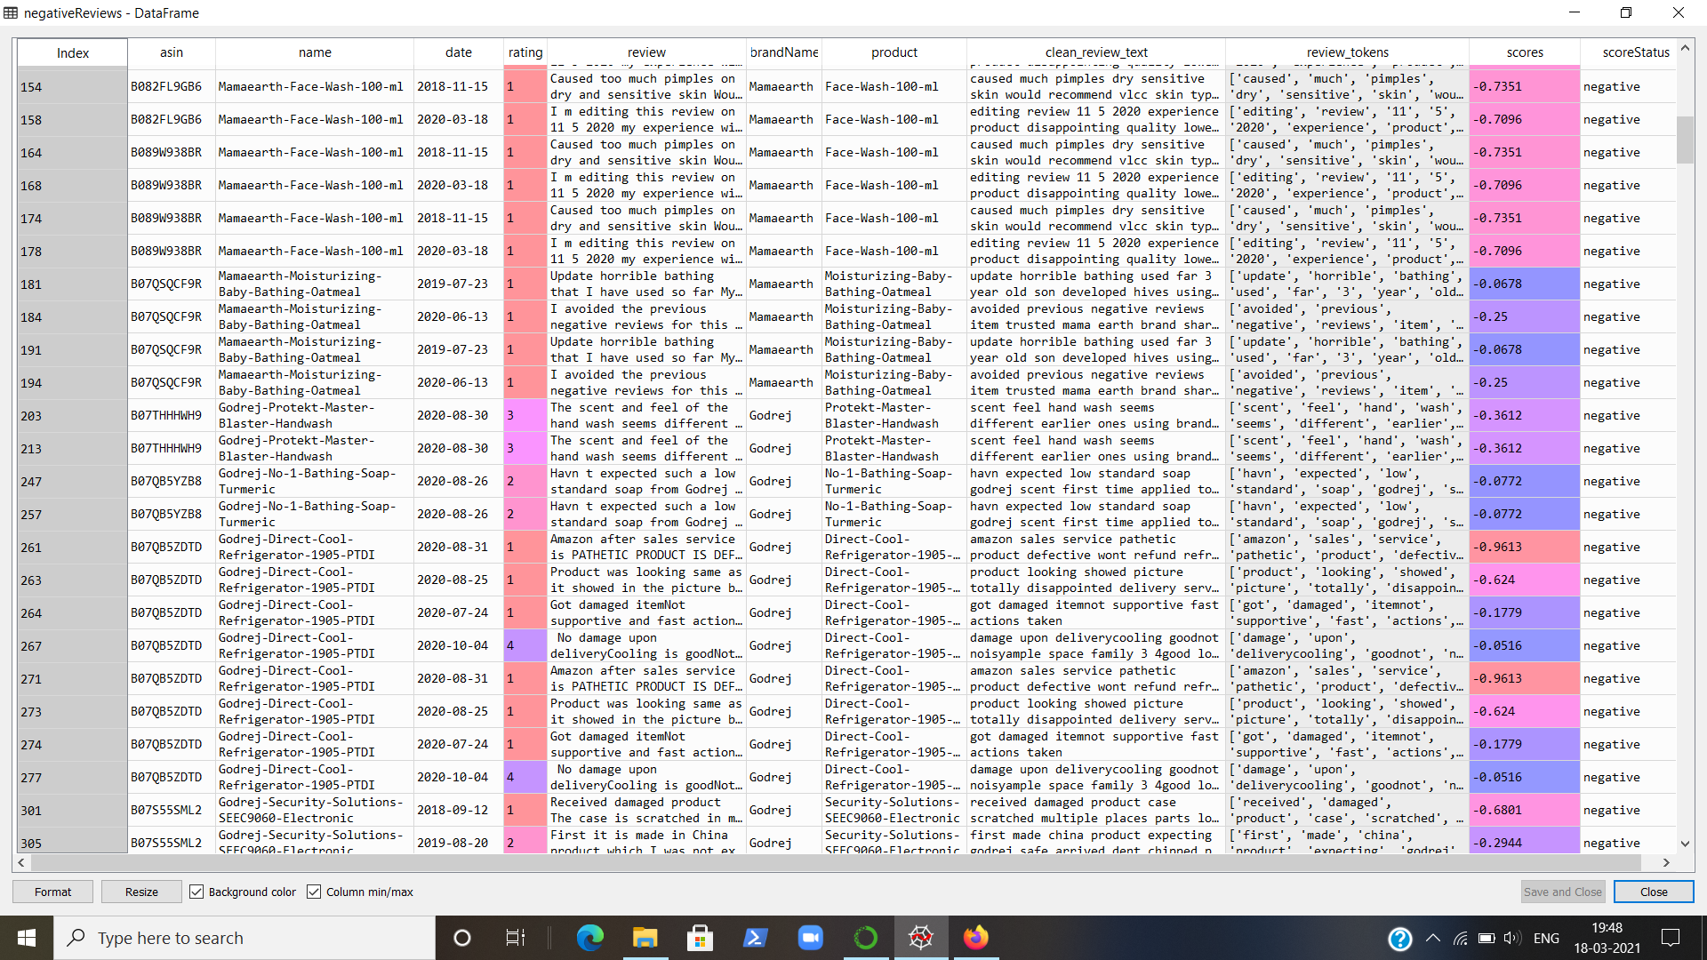
Negative Reviews
Table 3 – Negative Reviews Data-frame

Slide 12
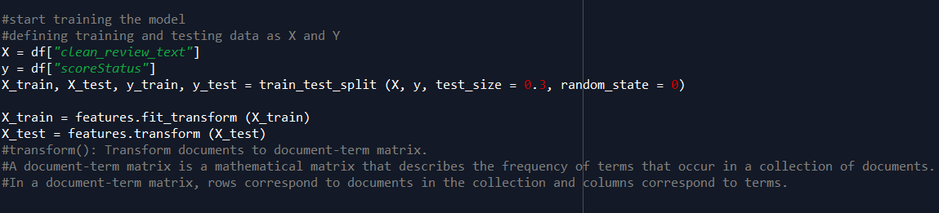
Methodology (continued..)
Data were split into training and testing data in 7:3 ratio.
Performed k fold cross validation with k = 5.
Applied Logistic Regression model to calculate the score of training and testing data respectively.
Calculated the frequency of tokenised words.
Fig. 5 – Code for splitting dataset into training and testing data

Slide 13
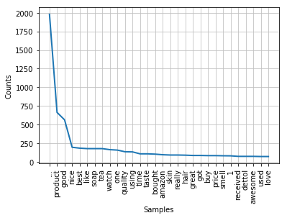
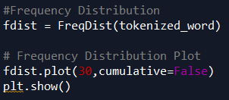
Frequency Distribution
Fig. 6 – Code for frequency distribution plot
Fig. 7 – Frequency Distribution Plot

Slide 14
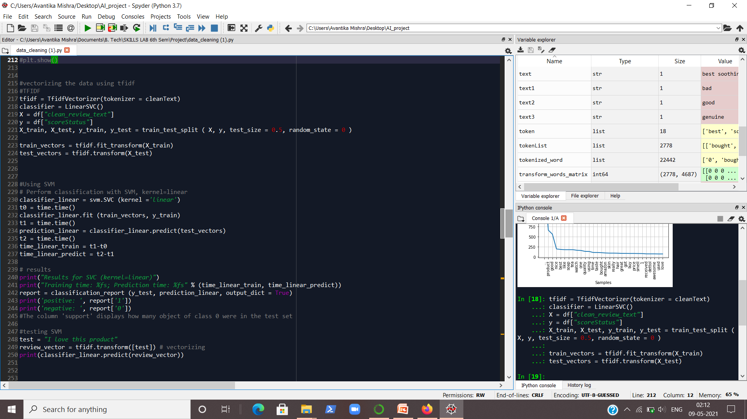
Vectorising using TF-IDF
Since results were not satisfactory, we vectorised the data using TF-IDF vectorizer.
Fig. 8 – Code for TF-IDF Vectoriser

Slide 15

Methodology (continued..)
Performed classification with SVM keeping kernel = Linear.
Used Baye’s model which gave an accuracy of 79.5%.
Used XGBClassifier to get an accuracy of 86.61%.
Finally implemented CNN by keeping a 8:2 ratio of training and testing dataset.
We first implemented the neural network layers by specifying 64 neurons/units in the dense layer using relu activation function.
Then we tried implementing with 32 neurons/units in the dense layer using relu.
Finally we used the softmax activation function by using 6 neurons in the dense layer and keeping a dropout rate of 0.2 in each case.
CNN gave an overall accuracy of nearly 89% which is our final accuracy.

Slide 16
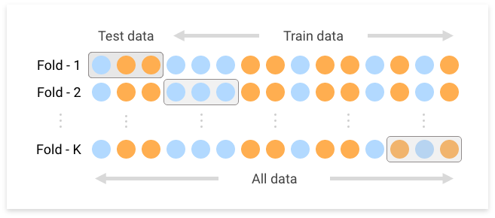
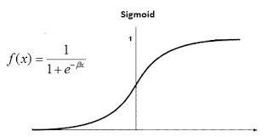
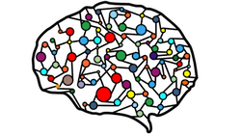
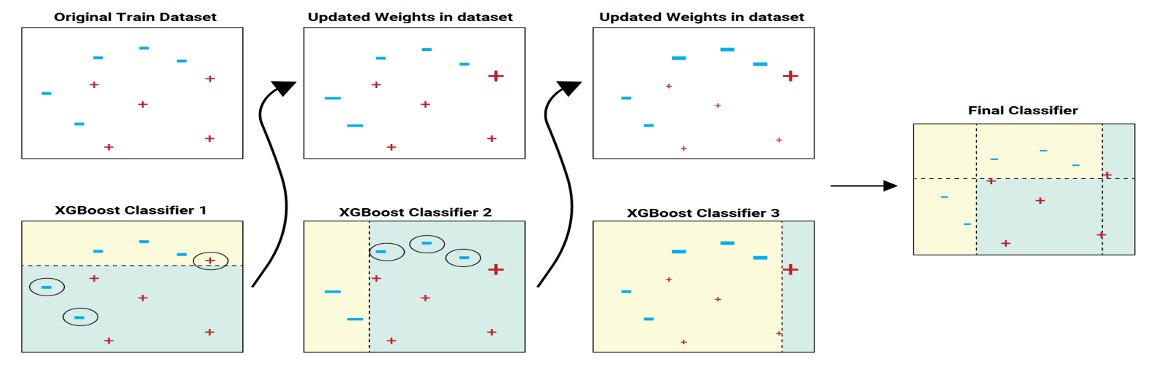
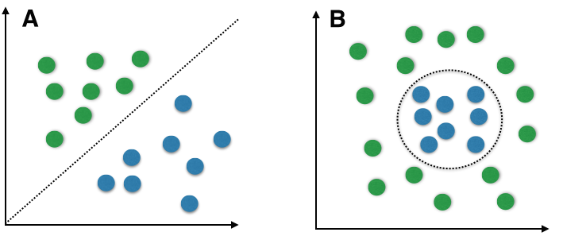
Models used and their respective Results

Slide 17
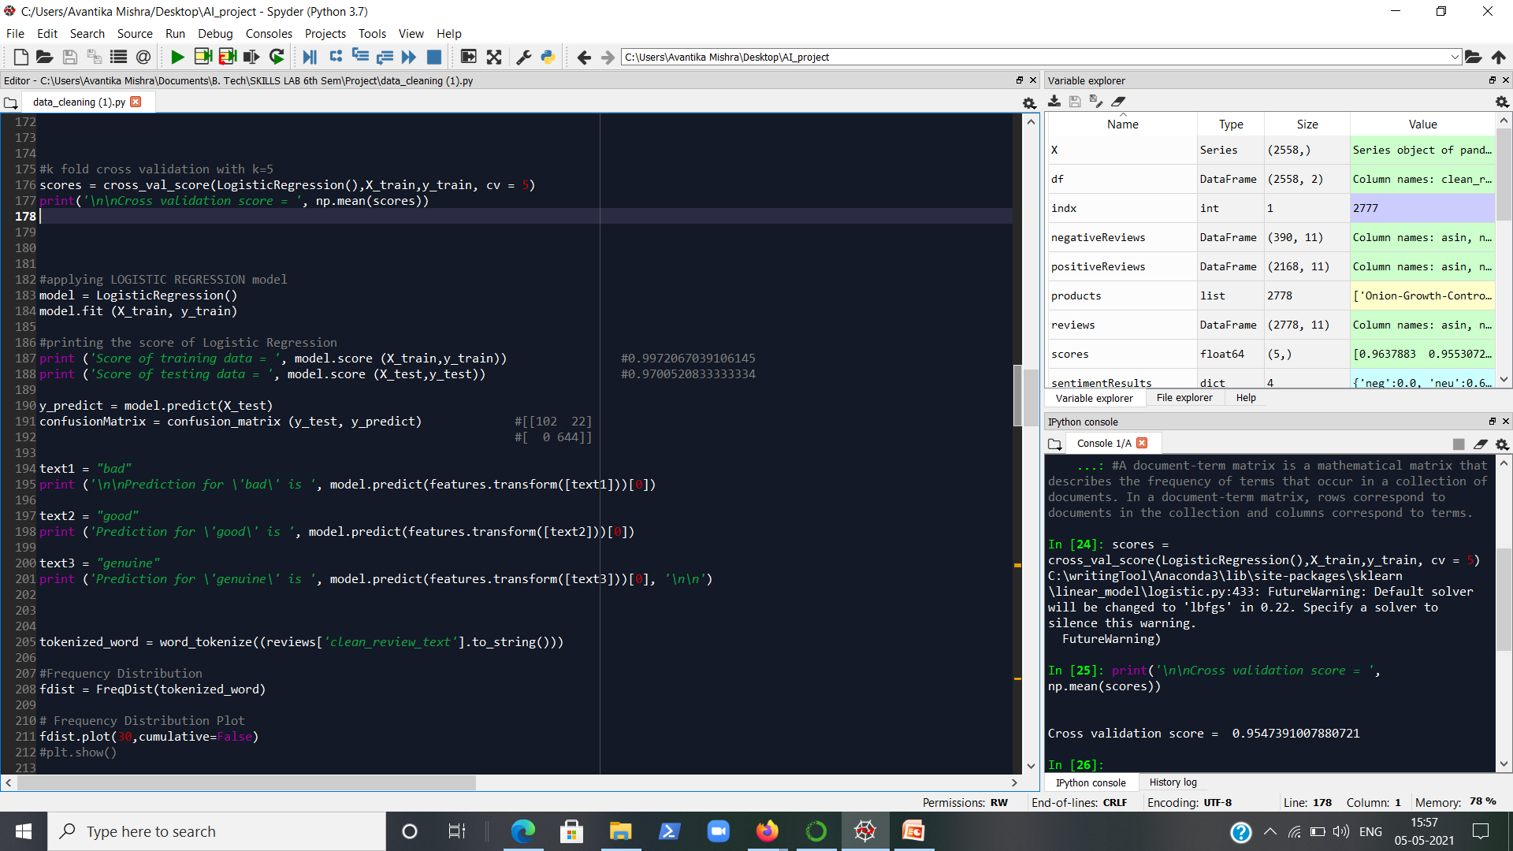
K-fold Cross Validation
Fig. 9 – K-fold cross validation code
Code for K-fold cross validation
Result for K-fold cross validation
Fig. 10 – Cross Validation Score

Slide 18
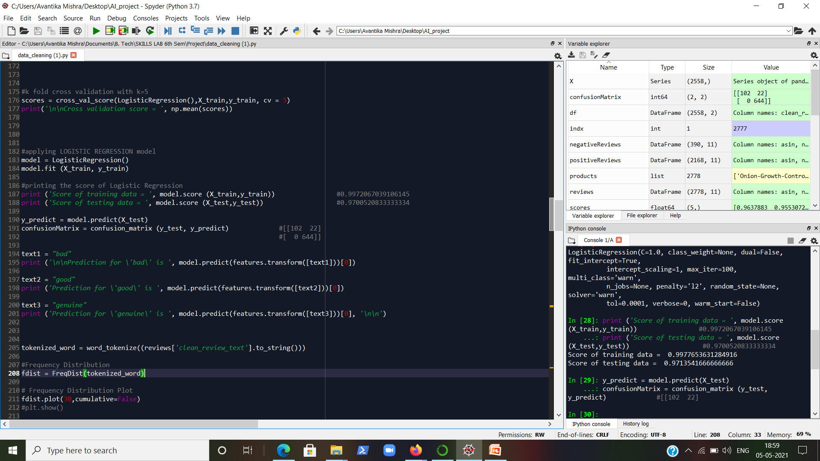
Logistic Regression
Code for Logistic Regression
Fig. 11 – Code for Logistic Regression
Score of Logistic Regression
Fig. 12 – Score of Logistic regression

Slide 19
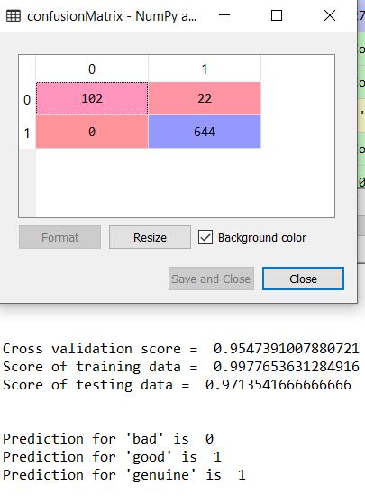
Confusion Matrix
Fig. 13 – Confusion Matrix
Result of Logistic Regression on new test data
Fig. 14 – Prediction of logistic regression

Slide 20
Support Vector Machine
Code for SVM
Fig. 15 – Code for SVM

Slide 21
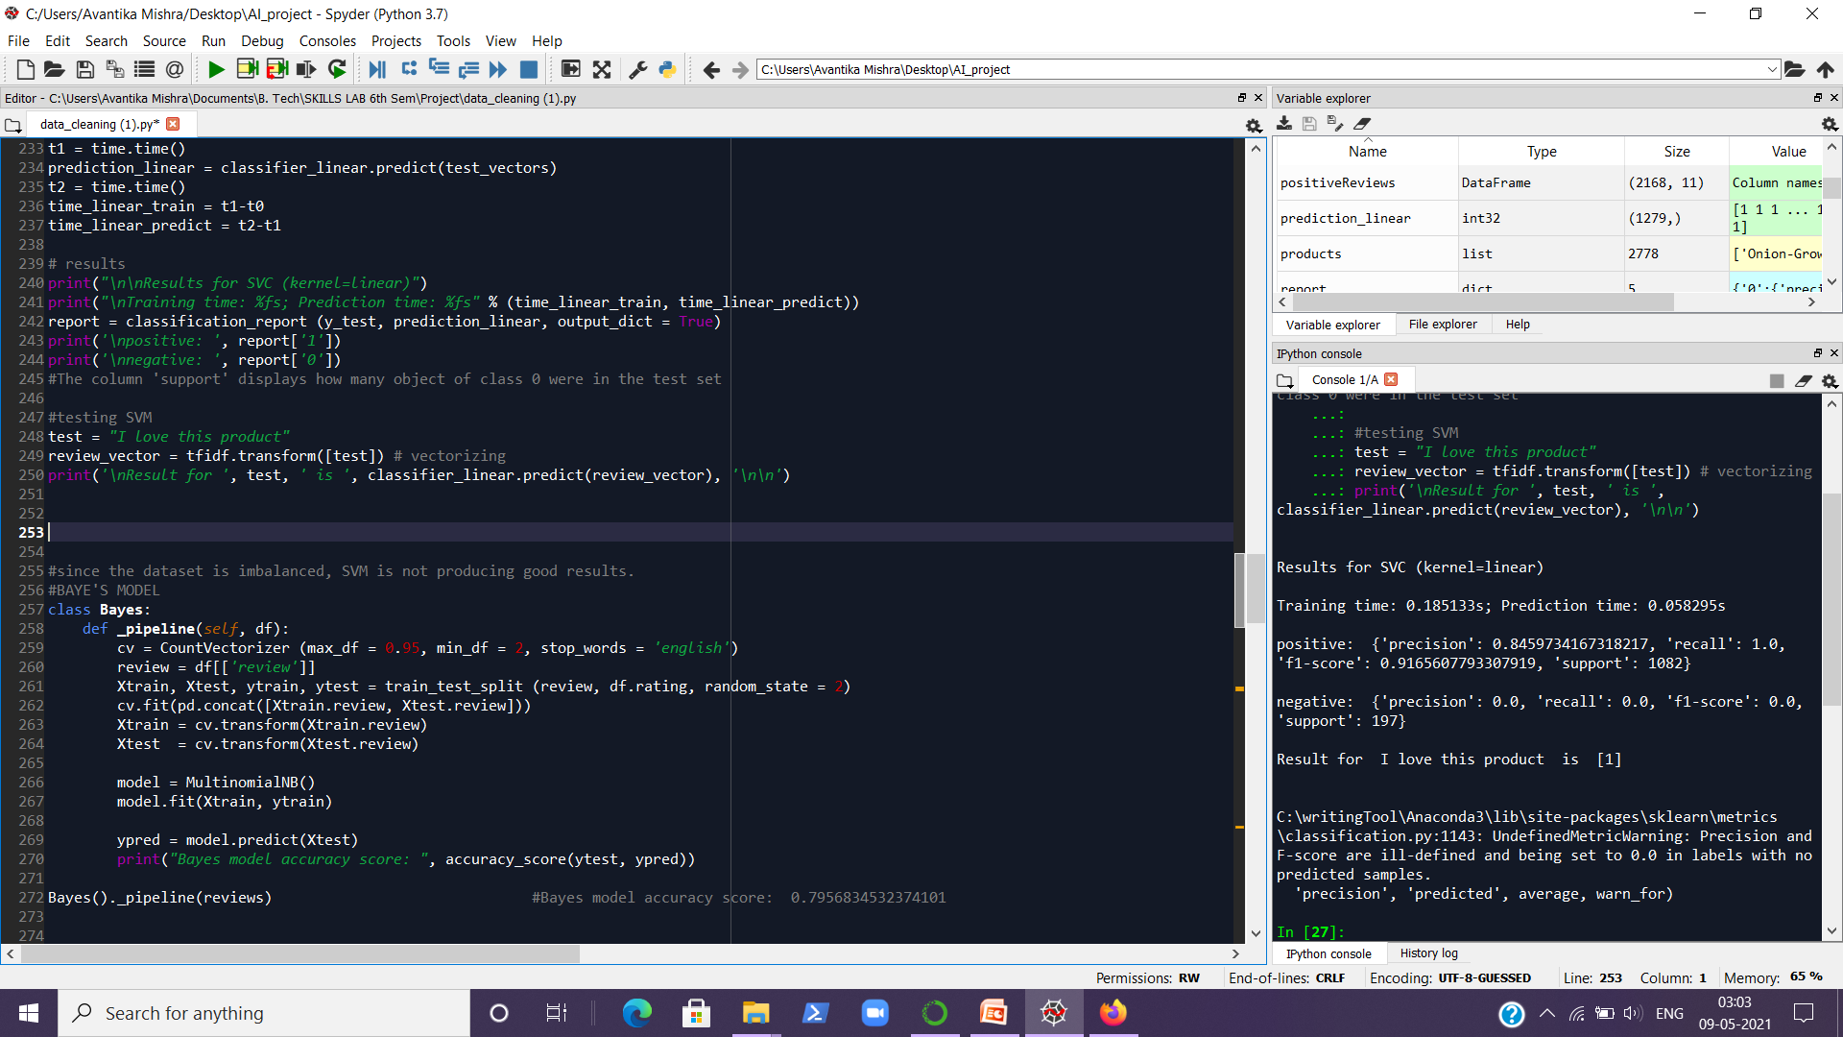
Result of SVM
Fig. 16 – Result of SVM

Slide 22
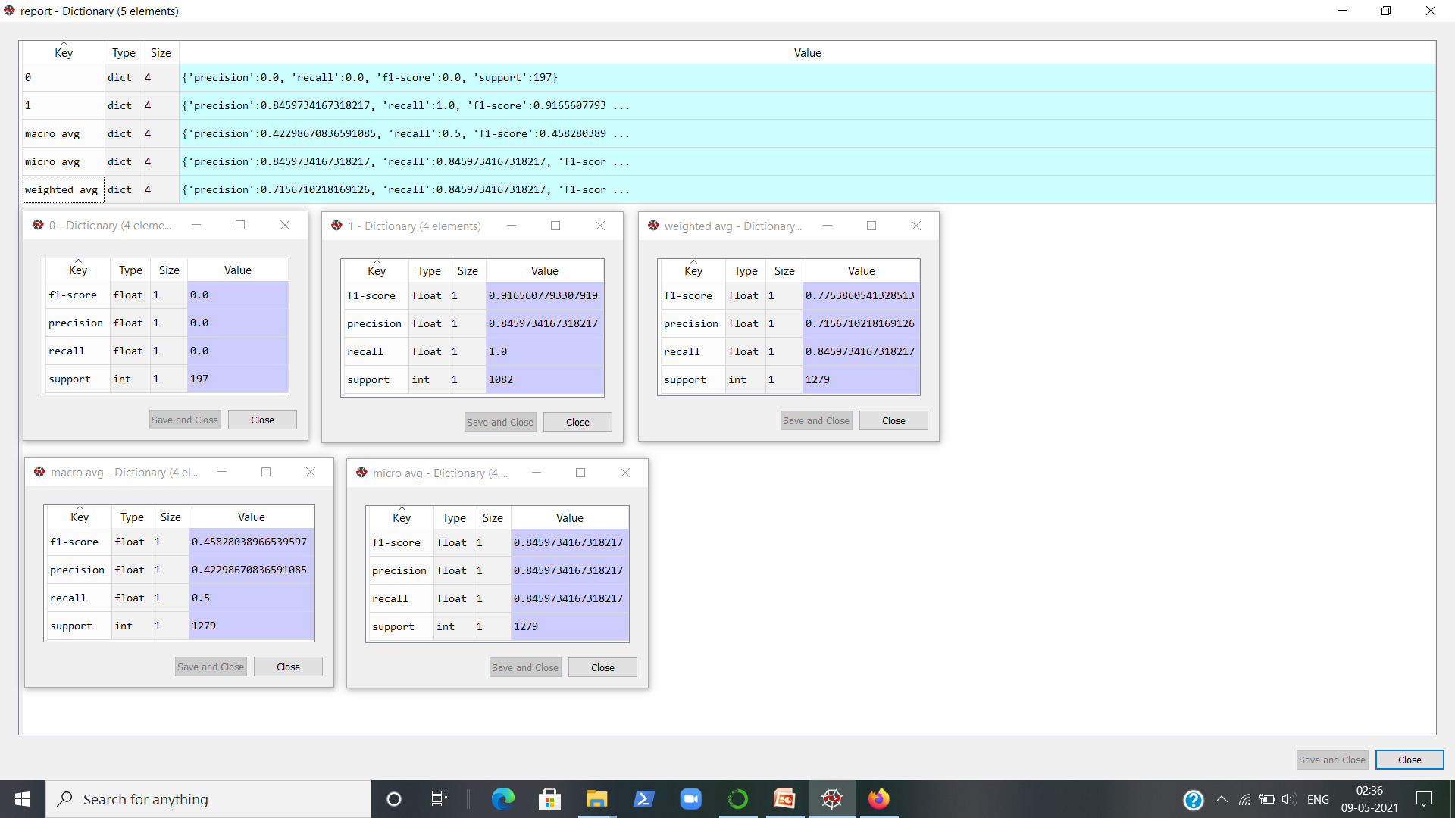

Classification Report of SVM
Fig. 17 – Classification Report

Slide 23
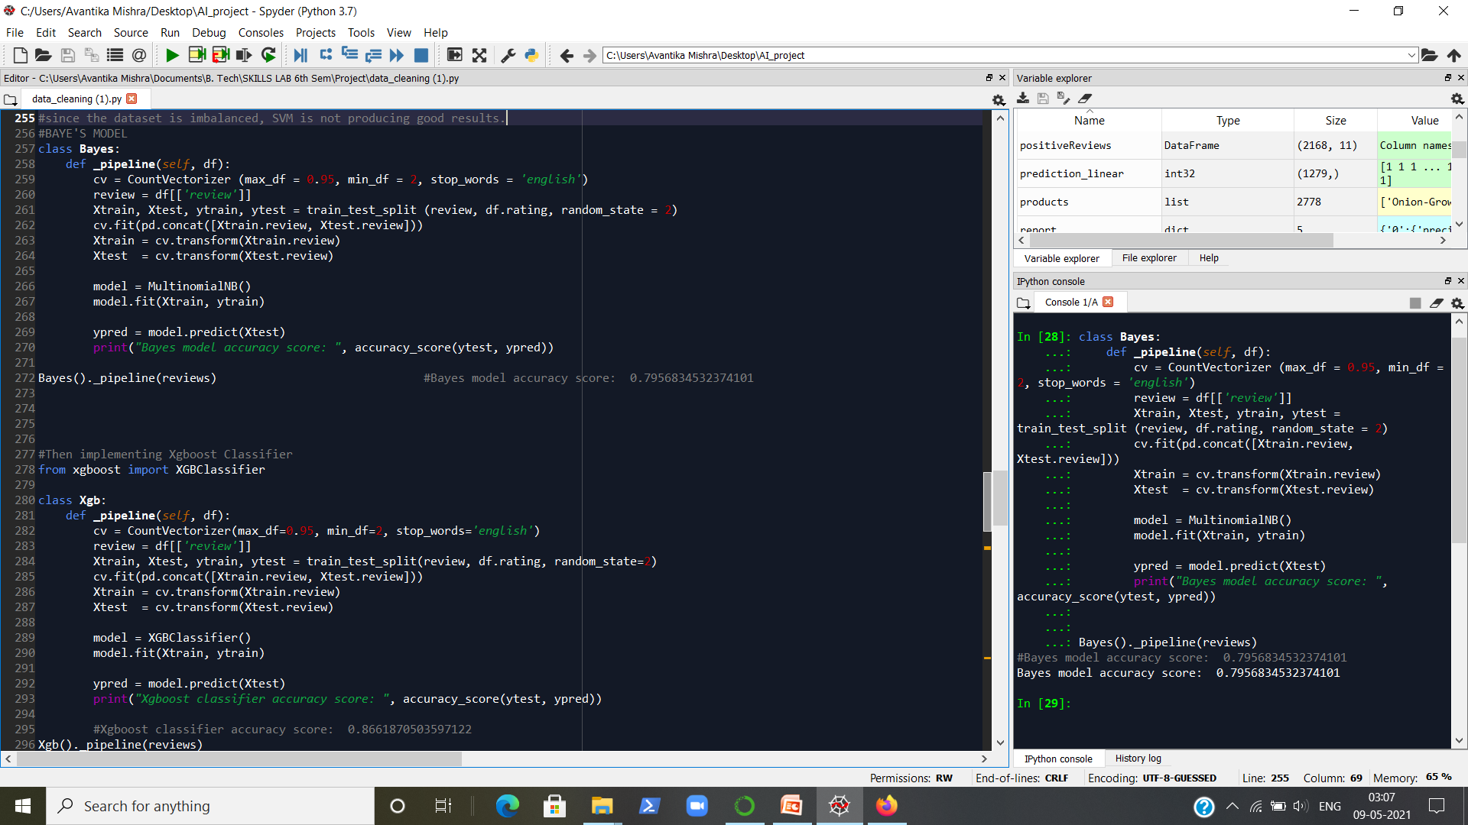
Multinomial Naive Baye’s Model
Fig. 18 – Baye’s model algorithm and accuracy

Slide 24
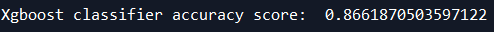
Xgboost Classifier
Code of Xgboost algorithm
Result of Xgboost algorithm
Fig. 19 – Xgboost Classifier implementation and accuracy

Slide 25
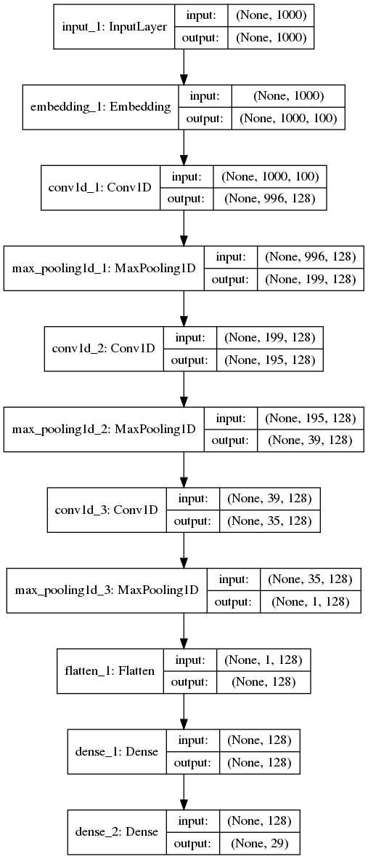

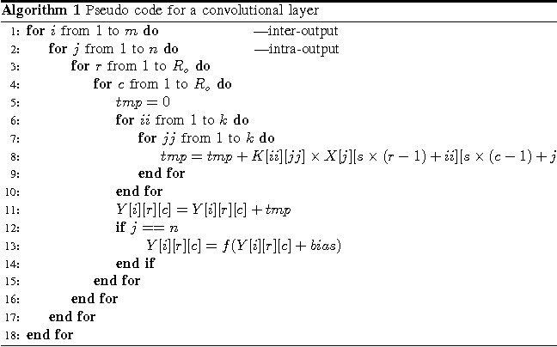
CNN
CNN Architecture

Slide 26
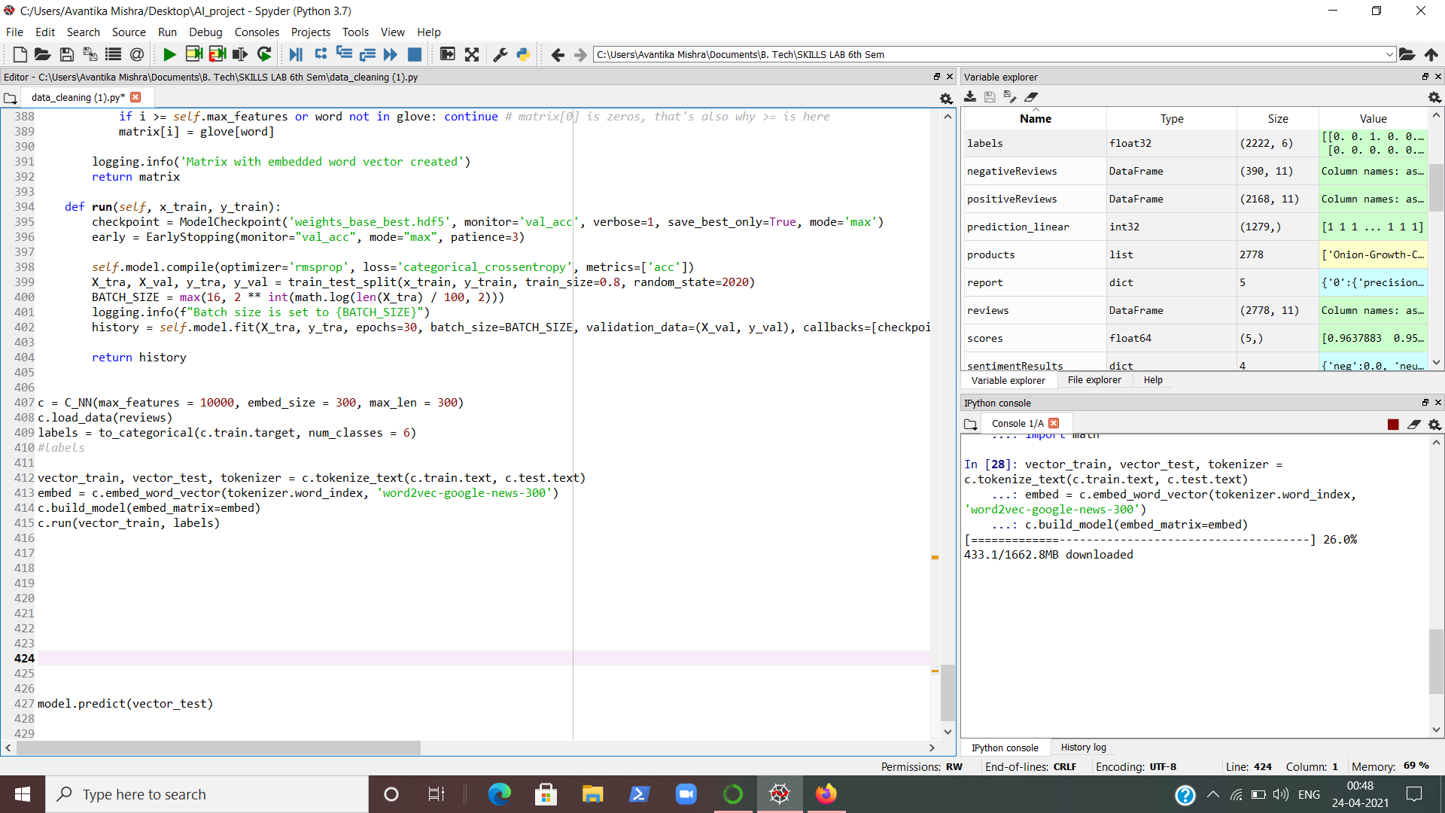
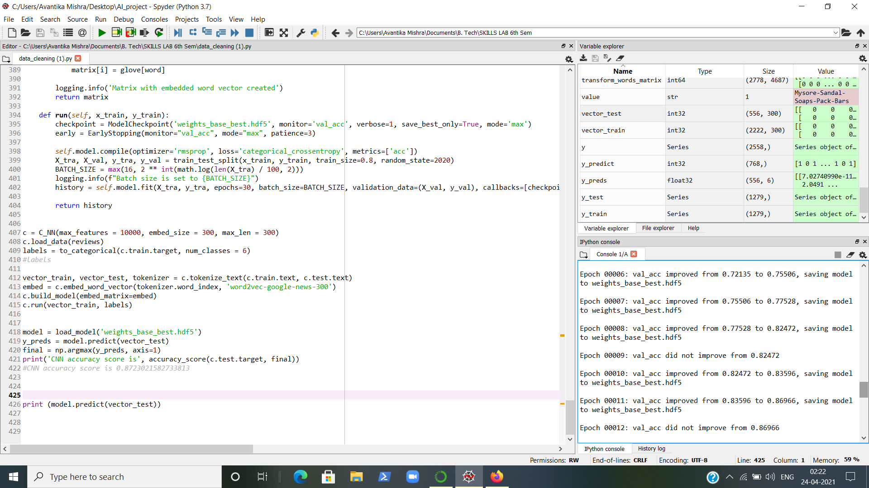
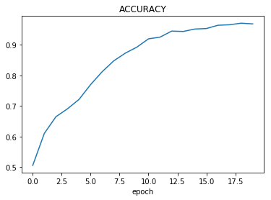
Training the CNN Model
Fig. 21 – Graph of how accuracy has increased while training
Fig. 20 – A glimpse of model training

Slide 27
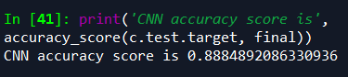
Final Accuracy of the Model
Fig. 22 – Final accuracy

Slide 28
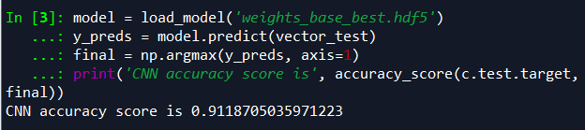
After repeated training, accuracy went up to ....
Fig. 23 – Maximum accuracy so far

Slide 29
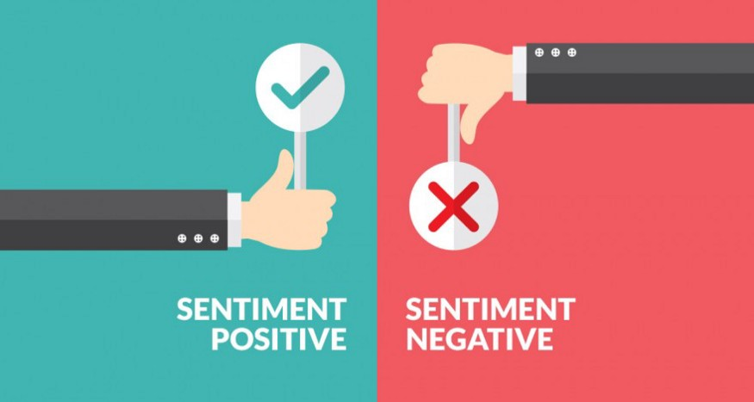
Demonstration of the Model

Slide 30
Conclusions and Future Scope
Cleaned the data, taken the clean_review_text as our X values of training and testing.
Binary values have been given to the positive and negative reviews.
Used Logistic Regression and SVM initially on the imbalanced dataset.
Then trained the data on Baye’s model, Xgboost Classifier and CNN models with a final accuracy of 88.85%.
The layers and configuration of the CNN may be improved to increase the accuracy of the model.
Some work on managing the imbalance may be done (using techniques like SNOTE) so that other models can be tried as well. But in such a case, special care has to be taken to avoid over-fitting.
The following potential strategies may be used to boost the score:
Embed a different pre-trained model, such as 'glove-wiki-gigaword-300'
Use Bidirectional Encoder Representations from Transformers： BERT
Collect more data and feed them into the model.

Slide 31


